Slide 1

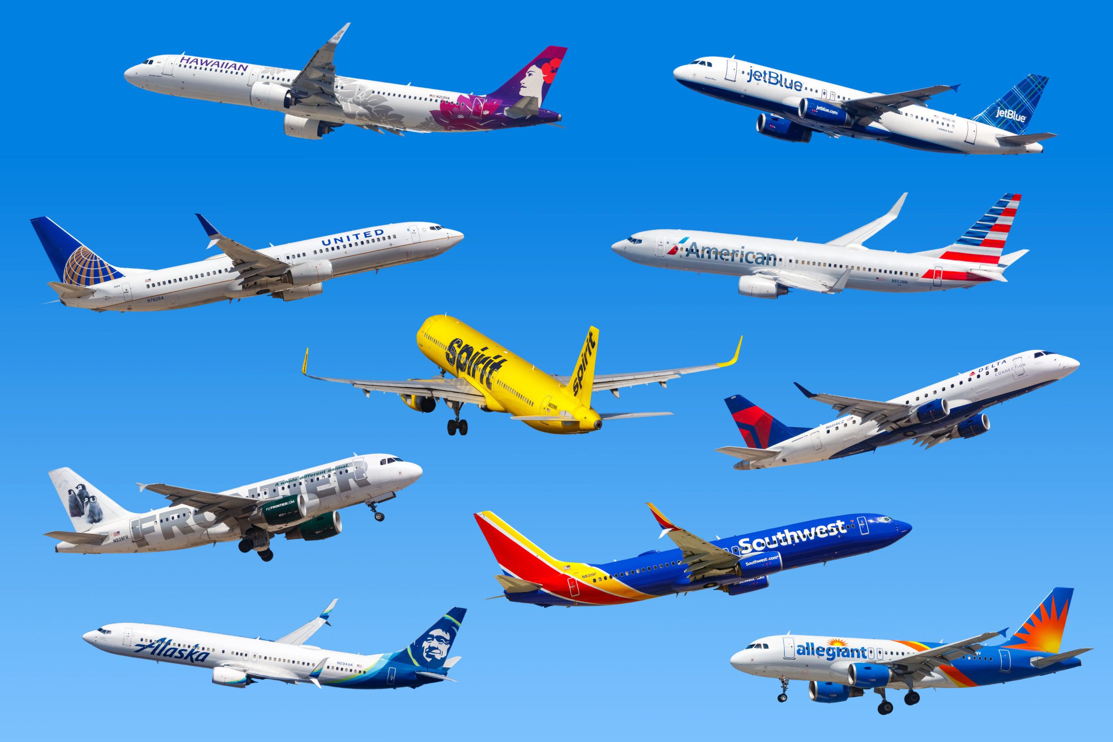

Automation At Sirius
By Sawan Chawla

Slide 2
Agenda
Background
Strategic Problem
Customer Segmentation
AI Strategy
Value Network
Conclusion
References

Slide 3


Background
Founded in 2010 as a low-cost carrier headquartered in Los Angeles.
Competes directly with Jet Blue as well as both ultra low-cost carriers Frontier and Spirit Airlines.
Ranked among the global top 10 for inflight experience and the leading U.S. airline.
Pre-pandemic operations included a fleet of 160 aircraft to 320 destinations.
Post-pandemic operations saw a reduction in fleet size down to 140 with 300 destinations
Currently planning an ambitious expansion but faces various threats to it.
This Photo by Unknown Author is licensed under CC BY-NC-ND

Slide 4

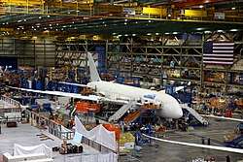
Strategic Problem
Market experiencing a slow down in jet deliveries due to supply chain issues plaguing both Airbus and Boeing.
This threatens Sirius strategic positioning for expansion, as well as may cause airline to incur losses due to flight cancellations to other destinations because of delivery slow downs. Overhauls maintenance cost in aging fleet as well.
Growing sustainability pressure is unavoidable, Sirius must address or face costly consequences of adopting sustainability practices later.
Work force shortage due to unaffordable cost of training, mandatory retirement for aging industry. This threatens Sirius expansion plans as well as causes financial losses for airline in terms of talent allocation and resource waste due to cancelled flights.

Slide 5
Customer Segmentation
Sirius falls into the early majority given the situation
This group is conservative in nature but open to new ideas.
Waits for technology such as AI to grow and mature before adopting the technology.

Slide 6

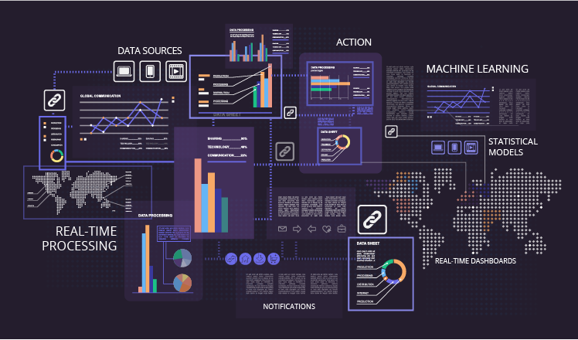
AI Strategy
Sirius AI algorithm strategy revolves around a common theme of partnerships in its value network
Rather than deriving innovation, it can leverage the pre-existing firms through partnerships to use AI and save the company immensely in terms of costs.
This short-term strategy can serve as a benchmark for Sirius to develop more permanent solutions using join ventures with its partners as well as effectively transform into an AI company.

Slide 7
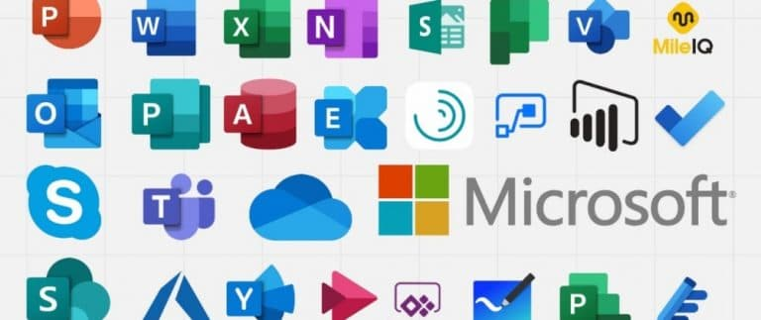

Value Network
Sirius value network primarily consists of two major AI Companies: Microsoft and HireVue.
Partnership with Microsoft can allow Sirius to leverage its ecosystem to improve various processes including hiring, planning, maintenance and sustainability practices.
Partnership with HireVue enables for a major reduction in biasness in hiring process while also selecting candidates without jeopardizing key talent.

Slide 8
Conclusion
The strategic problems plaguing the company – supply chain disruptions, sustainability pressures due to regulation, and key improvements to the hiring process to address labor shortages, can be solved using AI
This solution can serve as a benchmark for Sirius to take off and elevate the company standing to become a renowned innovator in AI but also solve its current predicament for short term. Additionally, this also allows Sirius to carry forth with its expansion and exceed pre-pandemic levels as well as standings in the airline industry.
Satya Nadella, CEO of Microsoft once said “This next generation of AI will reshape every software category and every business, including our own. Although this new era promises great opportunity, it demands even greater responsibility from companies like ours.” (Taylor, 2024).

Slide 9
References
Analysis, D. (2024, October 6). Improving supply chain efficiency with Power Bi. Medium. https://medium.com/microsoft-power-bi/improving-supply-chain-efficiency-with-power-bi-b8eec6b1f915#:~:text=Predictive%20analytics%20powered%20by%20Power,bottlenecks%2C%20and%20optimize%20resource%20allocation.
Aqsanoor. (2024, May 27). Discovering employee insights with Power Bi: A guide to HR analytics. CodeSuite. https://codesuite.org/blogs/discovering-employee-insights-with-power-bi-a-guide-to-hr-analytics/#:~:text=Using%20Power%20BI%20to%20track,%2C%20line%20graphs%2C%20and%20scorecards.
Arrington, E. (2022, March 23). The technology adoption life cycle and sticky notes [the formula to quickly reach the right market]. AKF Partners. https://akfpartners.com/growth-blog/technology-adoption-life-cycle-reach-the-right-market
Bureau, A. W. (2024, November 16). International HR News : Southwest Airlines offers buyouts amid operational adjustments. https://amazingworkplaces.co/international-hr-news-southwest-airlines-offers-buyouts-amid-operational-adjustments/#:~:text=Boeing’s%20Reduced%20Deliveries&text=Originally%20planning%20to%20receive%2085,to%20expand%20its%20flight%20capacity.
Christensen, C. M. (2024, April 9). The Innovator’s Dilemma, with a New Foreword: When New Technologies Cause Great Firms to Fail. Harvard Business Review Press.
Finnair. (2024, August 9). How route and aircraft management lowers fuel use and emissions. https://www.finnair.com/us-en/bluewings/sustainability/how-route-and-aircraft-management-lowers-fuel-use-and-emissions-2423058
Gates, D. (2024, July 24). What do Boeing and Airbus Share? parts shortages and a supplier crisis. The Seattle Times. https://www.seattletimes.com/business/boeing-aerospace/what-do-boeing-and-airbus-share-parts-shortages-and-a-supplier-crisis/
Gow, G. (2024, May 9). Six ways to use AI (including CHATGPT) to solve the labor shortage in 2024. Forbes. https://www.forbes.com/sites/glenngow/2024/02/25/six-ways-to-use-ai-including-chatgpt-to-solve-the-labor-shortage-in-2024/

Slide 10
References
Hanke, M., Dehne, F., Thiel, S., Weinfurter, A., Herr, D., & Sachdeva, N. (2023, December 21). Strategic pricing for airline sustainability. Roland Berger. https://www.rolandberger.com/en/Insights/Publications/Pricing-sustainability-the-right-way.html
Harper, L. (2023, June 8). Frustration grows as more airlines report aircraft maintenance and delivery delays. Flight Global. https://www.flightglobal.com/airlines/frustration-grows-as-more-airlines-report-aircraft-maintenance-and-delivery-delays/153570.article
Heilakka, R., & Murray, G. (2022, July 12). The airline pilot shortage will get worse. Oliver Wyman - Impact-Driven Strategy Advisors. https://www.oliverwyman.com/our-expertise/insights/2022/jul/airline-pilot-shortage-will-get-worse.html#:~:text=As%20the%20recovery%20continues%20to,from%20the%20military%2C%20and%20a
HireVue hiring platform: Video interviews, assessment, scheduling, AI, chatbot: Hirevue. hirevue.com. (n.d.). https://www.hirevue.com/
Iansiti , M., & Lakhani , K. R. (2020, January 7). Competing in the Age of AI: Strategy and leadership when algorithms and networks run the world. Harvard Business Review Press.
Knapp, O., Siepen, S., Mair, R., Schmitt, P., Zühlke, H., Hayes, G., Hoyer, M., Kourkejian, V., Schober, K.-S., Weichenhain, U., Campagna, F., Igarashi, M., Longstaff, T., Neumair, U., Pfeiffer, W., Vilchez, J. L., Fundulea, D., Jaspart, P., & Koper, S. (2023, March 13). Reducing scope 3 emissions – the next step toward decarbonization. Roland Berger. https://www.rolandberger.com/en/Insights/Publications/Reducing-Scope-3-emissions-The-next-step-toward-decarbonization.html

Slide 11
References
Kumar, A. (2023, August 5). How helpful is power BI in logistics management?. LinkedIn. https://www.linkedin.com/pulse/how-helpful-power-bi-logistics-management-anurodh-kumar#:~:text=Route%20Optimization%3A%20Power%20BI%20can,efficient%20routes%20and%20delivery%20schedules.
Lavri, O. (2024, December 2). Overcoming workforce challenges in a booming aviation market. HRForecast. https://hrforecast.com/the-aviation-labor-shortage-challenges-and-solutions/#:~:text=As%20demand%20has%20recovered%2C%20airlines,%2C%20ground%20staff%2C%20and%20technicians.
Lohawala, N., & Wen , Z. P. (2024). (rep.). https://media.rff.org/documents/Report_24-07.pdf. Resources for the Future. Retrieved from https://media.rff.org/documents/Report_24-07.pdf.
Murray, G., & Green, J. (2021, March 1). After covid-19, aviation faces a pilot shortage. Oliver Wyman - Impact-Driven Strategy Advisors. https://www.oliverwyman.com/our-expertise/insights/2021/mar/after-covid-19-aviation-faces-a-pilot-shortage.html#:~:text=In%20a%202019%20Oliver%20Wyman%20poll%20of,to%20entry%2C%20including%20the%20cost%20of%20training.
Parrish, S. (2020, July 10). Job interviews don’t work. Farnam Street. https://fs.blog/job-interviews/
Skills shortage continues to challenge aviation - how the industry can respond. Strategic Risk Global. (2024, September 20). https://www.strategic-risk-global.com/hospitality-leisure-and-travel/skills-shortage-continues-to-challenge-aviation-how-the-industry-can-respond/1453101.article
Supply Chain Management: Microsoft Dynamics 365. Supply Chain Management | Microsoft Dynamics 365. (n.d.). https://www.microsoft.com/en-us/dynamics-365/products/supply-chain-management#:~:text=Dynamics%20365%20Supply%20Chain%20Management%20capabilities,streamline%20procurement%2C%20and%20optimize%20fulfilment.

Slide 12
References
Taylor, J. (2024, February 16). 16 inspiring quotes about ai. Peak. https://peak.ai/hub/blog/16-inspiring-quotes-about-ai/
Top 20 AI-driven interview platforms for efficient hiring in 2024. Pesto Tech: Hire Top Remote Developers Using The World’s First AI Recruiter. (n.d.). https://pesto.tech/resources/top-20-ai-driven-interview-platforms-for-efficient-hiring-in-2024#:~:text=into%20candidate%20performance.-,HireVue,insights%20for%20better%20hiring%20decisions.
Uphues, J. (2023, July 6). Tackling the aviation staff shortages. AI systems to optimize business processes. https://www.inform-software.com/en/blog/aviation/tackling-the-aviation-staff-shortages
Walker, S. (2024, October 21). How do aircraft delivery delays impact aviation & why have they become such A hot topic?. Simple Flying. https://simpleflying.com/aircraft-delivery-delays-impact-analysis/

